Slide 1




Data Security Using CloudSplit
Team name :- DCEGGNHY
Members:-
Jatin Sharma
Parveen Saini
Deepak Beniwal
Garvit

Slide 2
Introduction
Every company is transferring their data on the cloud. So it is mandatory to protect that data against the hackers.
The Main focus is on the problem of data security in cloud and data transmission over cloud
The operations like encryption, compression and splitting done on the data that can be an image, text file etc at the local host and send it over the multi-cloud platforms .

Slide 3
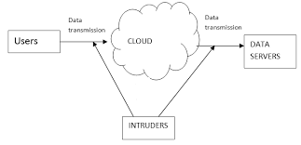
Current problem
The complete data firstly uploaded over the internet which is completely under the CSP(cloud service providers) eyes and then several encryption and decryption techniques done on it , then through a single transmission path all data transmitted which can easily hacked

Slide 4
How the project solve this problem...
First of all operations like splitting encryption and compression done on local host not over the internet hence for untrustworthy CSP’s the splitted encrypted and compressed data is the real one.
Since each splitted part of data is going to different server and a attacker can attacks only single transmission line so he only gets insufficient information

Slide 5
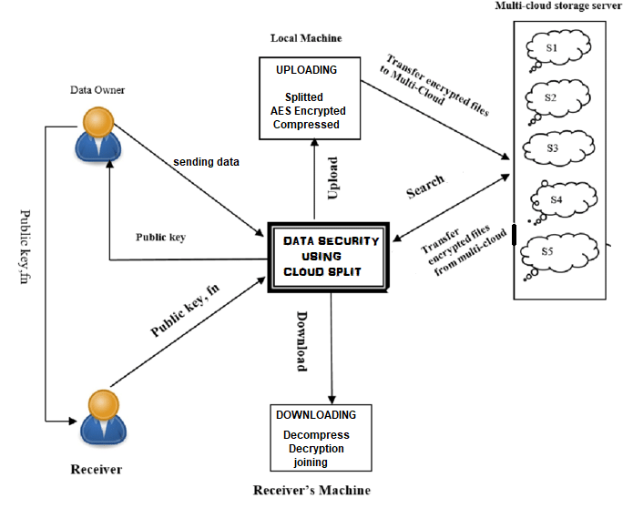
working

Slide 6


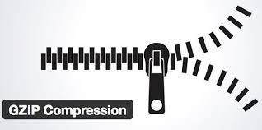
Modules
LSB Steganography
Encryption/Decryption (AES)
Data split/join
Compression/Decompression
Sharing and Downloading

Slide 7
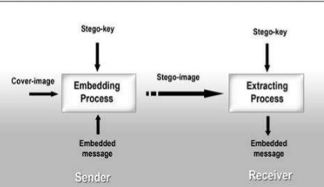
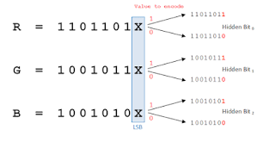
LSB Steganography
Steganography means hiding information in some other information
LSB-Steganography is a steganography technique in which we hide messages inside an image by replacing Least significant bit of image with the bits of message to be hidden.

Slide 8
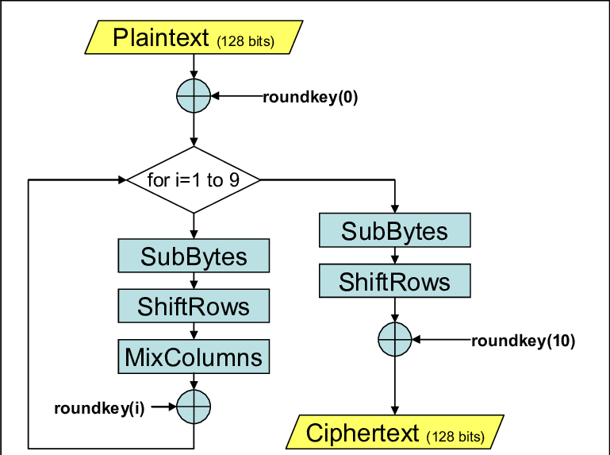
Encryption/Decryption (AES)
The Advanced Encryption Standard, or AES, is a symmetric block cipher
Till date, no practical cryptanalytic attacks against AES has been discovered
Software implementable in C and Java
Stronger and faster
Provide full specification and design details

Slide 9
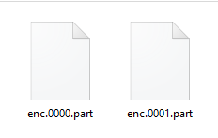
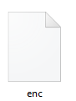
Data split/join
Splitting file in different parts with some extension (.part in our case). It then splitted and stored in our local system with extension .part.
Here the byte array is use in which convert the file into equal number of parts
The name.0000.part naming of splitted files are use in sequencing joining of splitted files.
(Splitted part)
(joined)

Slide 10
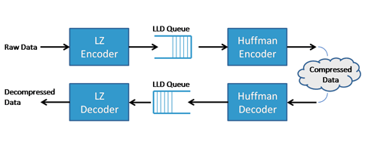
Compression/Decompression
In our system, splitted files get compressed with GZIPSTREAM algorithm so that the size of splitted files gets reduced, and it can easily be transferred to cloud server.
GZIP provides a lossless compression, that is, we can recover the original data when decompressing it.

Slide 11

Download and upload
The splitted data is now upload to the multiple clouds through FTP protocol
By using the user id which we provide in sharing process
The receiver’s end downloaded module contains all the file from where user can download and then perform all joining decryption and decompression

Slide 12

Application
Data security
Intelligence securities / defence
Data hiding
Industries

Slide 13
Demonstration….

Slide 14
Thank you…..

